Slide 1
Circulating securities and prospering the economy
Taiwan Stock Exchange Corporation
Introduction to Co-Location Service at TWSE First Data Center
2017/04/14
Easier fundraising for enterprises Safer investments for the public Corporate information transparency Fair trading mechanisms Diverse financial products

Slide 2
Table of Contents
1. The service
2. The work plan
3. Q&A
Easier fundraising for enterprises Safer investments for the public Corporate information transparency Fair trading mechanisms Diverse financial products

Slide 3
1. The service
2. The work plan
3.Q&A
Easier fundraising for enterprises Safer investments for the public Corporate information transparency Fair trading mechanisms Diverse financial products

Slide 4
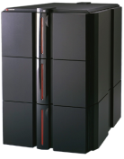
Co-Location vs. IDC
Server room at securities firm
Example:
IDC data center at telecommunications company
TWSE Data Center
Trading
system
Co-Location
data center
Traditional connection
Securities firm server
Securities trading
Information network
IDC connection
Securities firm server
TWSE matching engine and trading information system
Co-Location connection
Securities firm server
Notes:
所謂主機共置
三個location舉例說明

Slide 5
Co-Location Service Plan
4kW power supply
2 100Mbps lines
Securities firm can lease at least one rack
Co-Location
Space for one rack
Equal connection distance to all securities firms
Notes:
我們提供主機共置服務的內涵包括

Slide 6
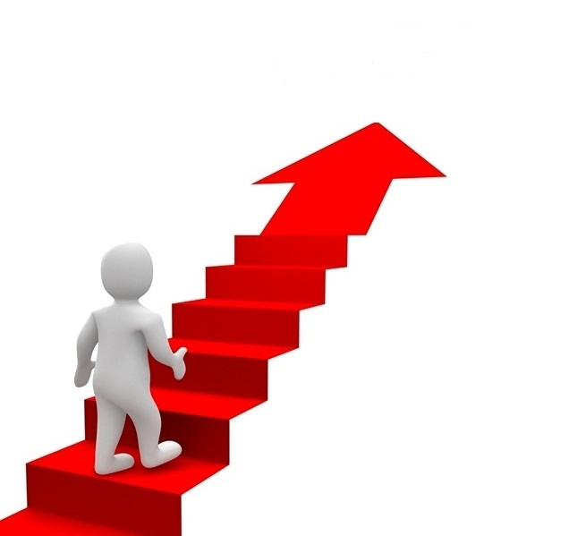
Value-added Co-Location Services
Lease of additional trade and market data lines
Point-to-point dedicated lines
Independently controlled access (cage)
Rack reservation (up to 6 months)
Rack relocation
Notes:
期能提供證券商更好的服務並為公司增加收益
加值服務供證券商選擇

Slide 7
Connection comparison
Differences | TWSE Co-Location | Example: Telecommunications company IDC | Traditional connection
Distance to trading information system |  | Nearby | Farther
Network speed |  | Second fastest | Slower
Network rent (at same speed) |  | Similarities
Market transmission latency |  | Second shortest | Longer
Order placing latency |  | Second shortest | Longer
Same building
Fastest
Cheapest
Shortest
Shortest
Notes:
舉例比較co-lo、IDC與傳統三種連線方式

Slide 8
1. The service
2. The work plan
3. Q&A
Easier fundraising for enterprises Safer investments for the public Corporate information transparency Fair trading mechanisms Diverse financial products

Slide 9
Customer's Checklist
Lease of racks and network lines.
Application to change auction equipment and connection.
Application to change real-time transmission of trading information.
The TWSE Co-Location service allows TWSE and securities firms to connect directly to the mainframes of data vendors and those of TWSE First Data Center. It does not provide connection to trading systems at other TWSE data centers.
Notes:
有關12/27指示辦理事項在此一併感謝交易部的協助

Slide 10
1. The service
2. The work plan
3. Q&A
Easier fundraising for enterprises Safer investments for the public Corporate information transparency Fair trading mechanisms Diverse financial products

Slide 11
Q&A (1/4)
Will market participants without Co-Location access be treated equally?
Existing latency difference in the market
- Different network bandwidths
- Distance to First Data Center
- Quality of routers or mainframes
- Quality of computer programming
Notes:
提供co-lo目的其實是希望公平地讓所有證商以較便宜租金取得co-lo服務

Slide 12
Q&A (2/4)
Will market participants with Co-Location access be treated equally?
A provision is added to the contract to require the use of the service be subject to fair treatment of investors. TWSE may impose a deadline for improvement on violation. Failure to meet the deadline may result in TWSE suspending or terminating the user agreement.
When a securities firm operates both proprietary trading and brokerage services, access to the service for the brokerage services shall not be subordinate to that for proprietary transactions, except for proprietary traders performing quoting obligations.
All servers of customers are connected to the trading system mainframes by identical distance.
Notes:
提供co-lo目的其實是希望公平地讓所有證商以較便宜租金取得co-lo服務

Slide 13
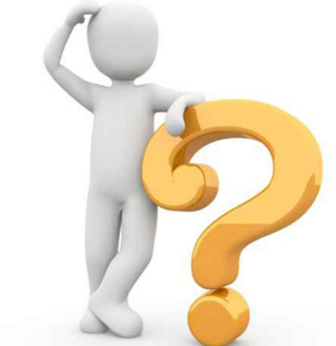
Q&A (3/4)
Would it be feasible for TWSE, TAIFEX, and TPEx share 1 rack but have separate and mutually independent lines for trading and market data transmission?
Technically feasible
No impact on securities firms and information vendors working with TWSE at present
Notes:
提供co-lo目的其實是希望公平地讓所有證商以較便宜租金取得co-lo服務

Slide 14
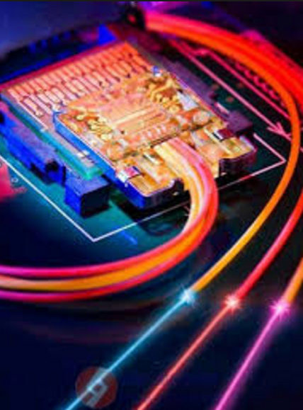
Q&A (4/4)
Is it possible to create network connection between racks?
Connection can be established between neighboring racks of the same company, but not between those of different companies.
Notes:
提供co-lo目的其實是希望公平地讓所有證商以較便宜租金取得co-lo服務

Slide 15
Thanks.

