Slide 1
Co-Location Seminar
2017/09/04

Slide 2
Outline
Schedule
Application process
3
Resource allocation
4
1
Introduction
2
5
Housing
6
Equipment testing
7
Fees
8
Miscellaneous

Slide 3
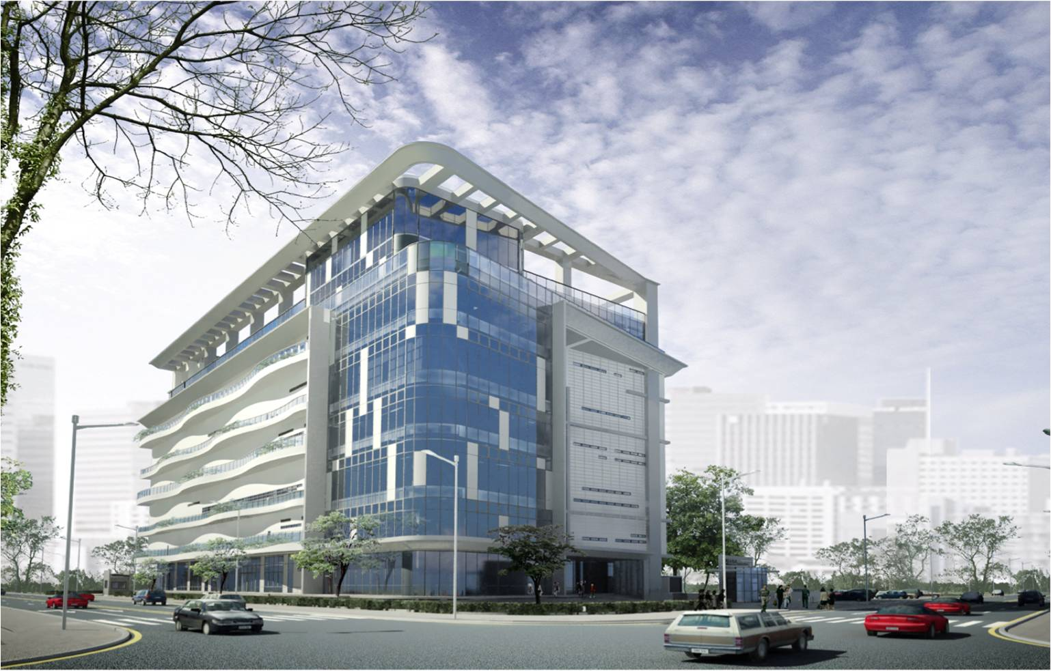
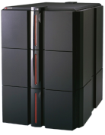
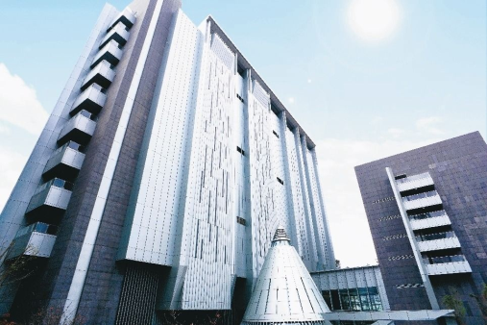
Introduction - Connection
Securities firm server
Co-Location
TWSE First Data Center
4-in-1 transaction information network
Securities firm server
TWSE matching engine and trading information system
Traditional
IDC data center
Securities firm server
IDC

Slide 4
Introduction - Co-Location by TWSE
Data center safety - based on TIA-942 Tier 4 (highest) data center standards
Physical environment: Earthquake resistance (7.0), flood proof (200-year flood), fire proof (24-hour fire rated exterior walls), and green building label.
Electricity: Taipower dual feed power supply system, two uninterruptible power supply systems, and two generators with sufficient fuel to supply power during a power outage.
Water source: 3-day supply of water in addition to water supply from the water treatment plant.
Rack - Constant temperature and humidity air conditioning
2 100M lines are provided, and 2 free 100M lines at the initial stage after the service is launched.
4KW power supply (UPS circuit)

Slide 5
Introduction - Co-Location
TWSE First Data Center
Securities firm server
Co-Location
(100M or 1G)*2
Low Latency
Offering 2 100M or 1G lines.
Environmental safety
Part of the country's critical infrastructures (CIs) and winner of CI excellence award.
Vibration isolation building, dual feed power supply, and constant temperature and humidity racks
Fairer treatment
Equal distance to the TWSE matching engine and trading information system.
TWSE matching engine and trading information system

Slide 6
Schedule
September 2017: Held Co-Location Seminar.
October 2017: Started accepting applications for racks, service contracts, competitive auction devices and stock trading data transmission, and client dedicated lines; and held user information session.
November 2017: Had user equipment moved into the premise at assigned times and tested by users.
December 2017: Completed marketwide testing (users who completed self testing) and launched the service for users.

Slide 7
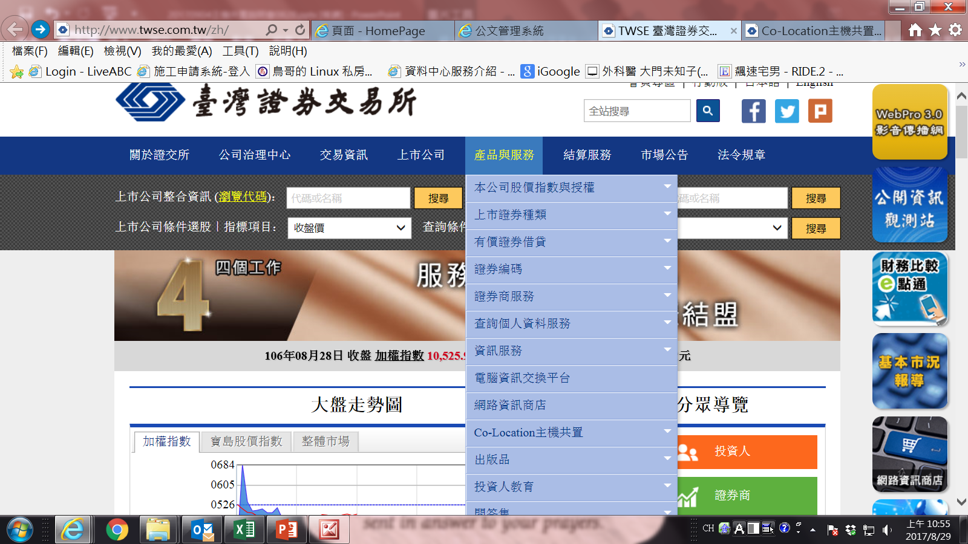
Co-Location application process (1/3)

Slide 8
Co-Location application process (2/3)
User downloads the contract and related documents.
Affix both corporate seals to the contract and send in the contract by mail.
TWSE affixes its seal to the contract in reply - with the URL for the Co-Location User Service System Handbook attached and the administrator account ID provided by notification (provide password by telephone).
All applications for service are to be made electronically in the Co-Location User Service System.

Slide 9
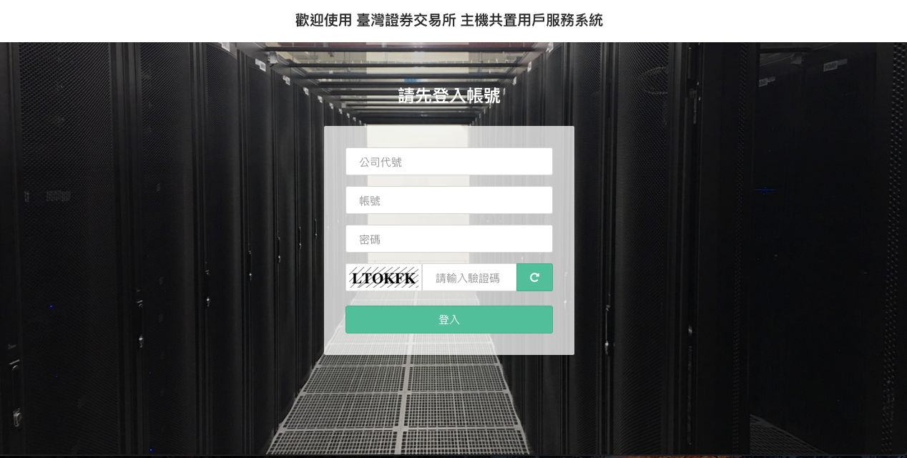
Co-Location application process (3/3)
Co-Location User Service System

Slide 10
Resource allocation
Resources to be allocated by application number
Rack location.
IP and line number to access trading and market information network.
User IP and dedicated line number for links from racks to user side.

Slide 11
Housing (1/2)
Target: Existing users under contract
Description:
Complete the application forms.
Construction coordination meeting.
Construction and maintenance schedule
Management guidelines.
Emergency procedures.
Introduce Co-Location data center environment.

Slide 12
Housing (2/2)
Co-Location first time housing
Please submit an application six days in advance.
Hold the construction coordination meeting during the period.
User equipment enters into the premise in the order of application. Controls are implemented to give access to vehicles and unloading and consideration to the size of data center staff.
TWSE personnel will assist with directing trucks, unloading and entering/exiting the data center.

Slide 13
Equipment testing
Co-Location user equipment testing
Marketwide testing Users who completed self testing can participate in marketwide testing and launch the system after marketwide testing.
Testing of auction terminal equipment and market information system follow the existing rules.
First time Fix users must complete AP testing before applying for launch.

Slide 14
Miscellaneous (1/3)
Dedicated line to link rack to user side
A 20-working-day period is needed between a telecommunications company receives an application and the line is installed.
All lines are leased and paid for by TWSE at preferred rates offered by the telecommunications companies.
Each user is free to select a telecommunications company (Chunghwa, FarEasTone, and TFN) and bandwidth.

Slide 15
Miscellaneous (2/3)
Any one rack can be used to apply for TWSE, TPEx, and TAIFX trading and market data systems at the same time.
To make Co-Location easier, TWSE makes best efforts to assign consecutive racks on the same row to members of the same group (except when members are information vendors).
When all existing racks have been assigned, applicants will have to wait for 4 to 6 months for new equipment to be installed.

Slide 16
Miscellaneous (3/3)
Co-Location announcements and downloads
Surf the TWSE’s official website (https://www.twse.com.tw) and select “Products & Services” then click on “Co-Location”.
Co-Location area URL: https://www.twse.com.tw/zh/page/products/colocationArea.html

Slide 17
Thanks.

